Slide 1
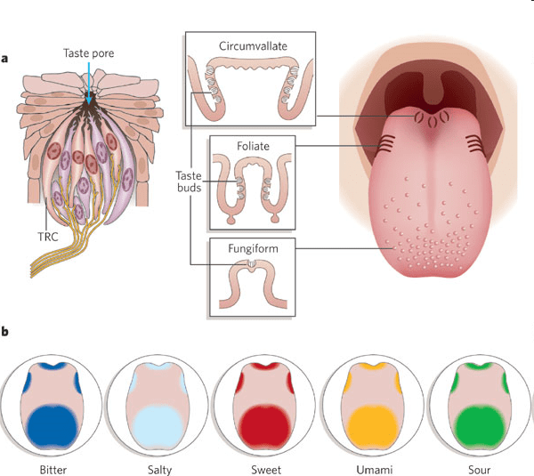
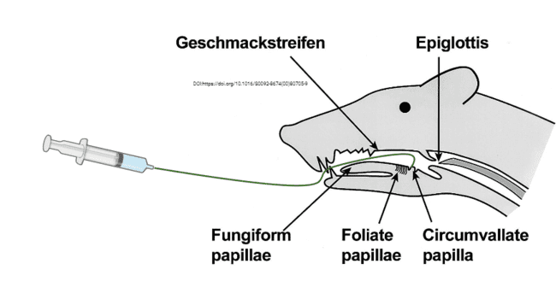
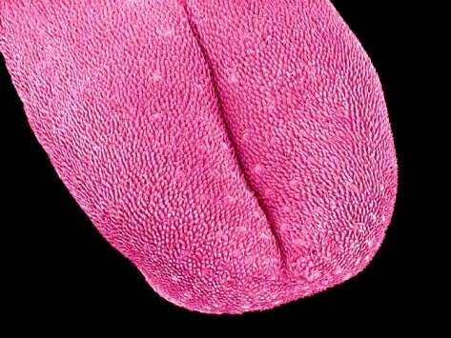
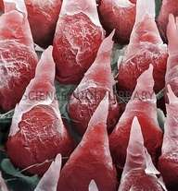
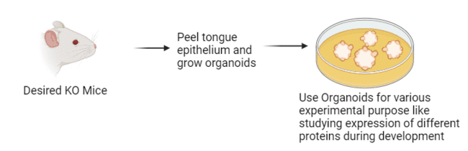
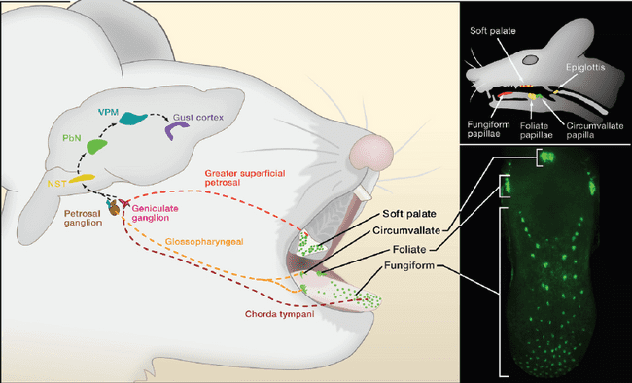
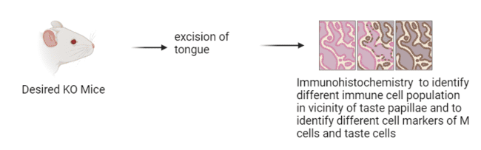
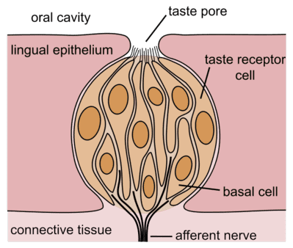
MUCOSAL IMMUNE SURVEILLANCE AT THE TASTE PAPILLAE
Abdul Hamid Siddiqui,
Sukumaran’s Lab, Nutrition and Health Sciences,
Taste Buds
Taste cells are continually exposed to the oral microbiota, but how this affects taste signaling is not known. In a recent study from our lab, it was reported that type II taste cells express Spib, a master transcription factor that regulates the regeneration of Microfold (M) cells, a key cell type involved in immune surveillance first identified in secondary lymphoid tissues such as Peyer’s patch and tonsils. M cells transcytose microbes and present them to immune cells that trigger an appropriate immune response. We hypothesize that type II taste cells and VDCs mediate immune surveillance in taste papillae, thereby regulating taste signaling.
Taste buds are the primary sensory organs of taste
Taste buds are found in three of the four types of papillae on the tongue
Microbeads Administration
Circumvallate
Foliate
Fungiform
10.1038/nature05401
Organoids
Filiform Papillae (the non-taste papillae)
KanayaT et. al (2020) Traffic.2020;21:34–44.
Mouse tongue with GFP expressed in T1R3 (sweet/umami receptor component) expressing cells
M cells have intraepithelial pocket housing immune cells, selective expression of microbe-binding receptors, and a high constitutive rate of apical-to-basolateral transcytosis of microbe-containing vesicles. The secondary lymphoid organs underlying them process the microbes and mount an appropriate immune response.
Circumvallate
Experimental Design
Foliate
Fungiform
The Taste Bud
Tight junctions
Four types of cells are present in taste buds out of which 2 are involved in taste perception type 2 and type 3
Type 2 taste cells perceive Sweet bitter and Umami tastes while Type 3 taste cells perceive salty and sour taste
Results
https://en.wikipedia.org/wiki/Taste

